Slide 1
Networks of Neurons
Computational Cognitive Neuroscience
Randall O’Reilly

Slide 2
Networks
Biology of Neocortex (“cortex”)
Categorization and Distributed Reps
Bidirectional Excitation and Attractors
Inhibitory Competition and Activity Regulation

Slide 3
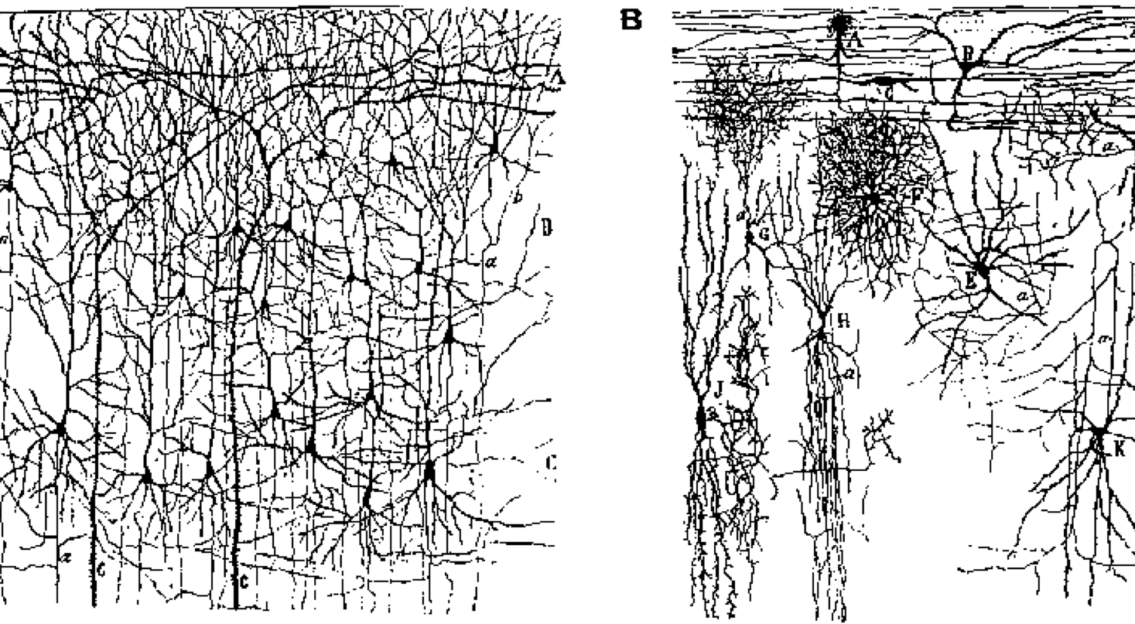
Neurons: Excitatory and Inhibitory
Excitatory = main info processing, long-range connections
Inhibitory = local, activity regulation and competition

Slide 4
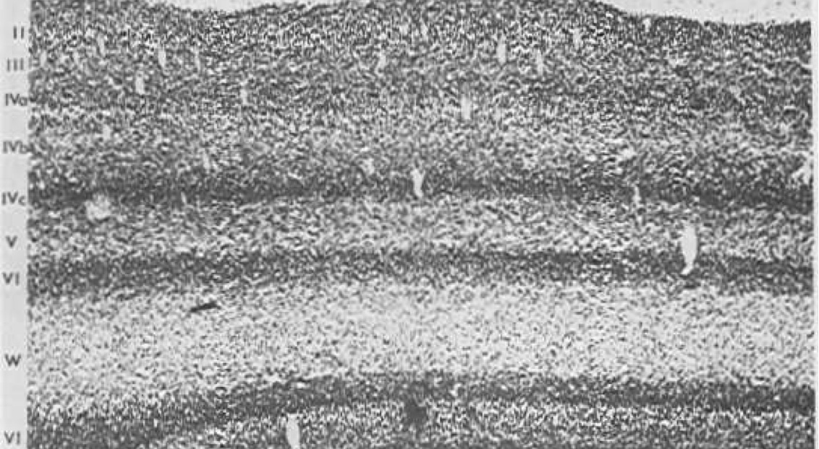
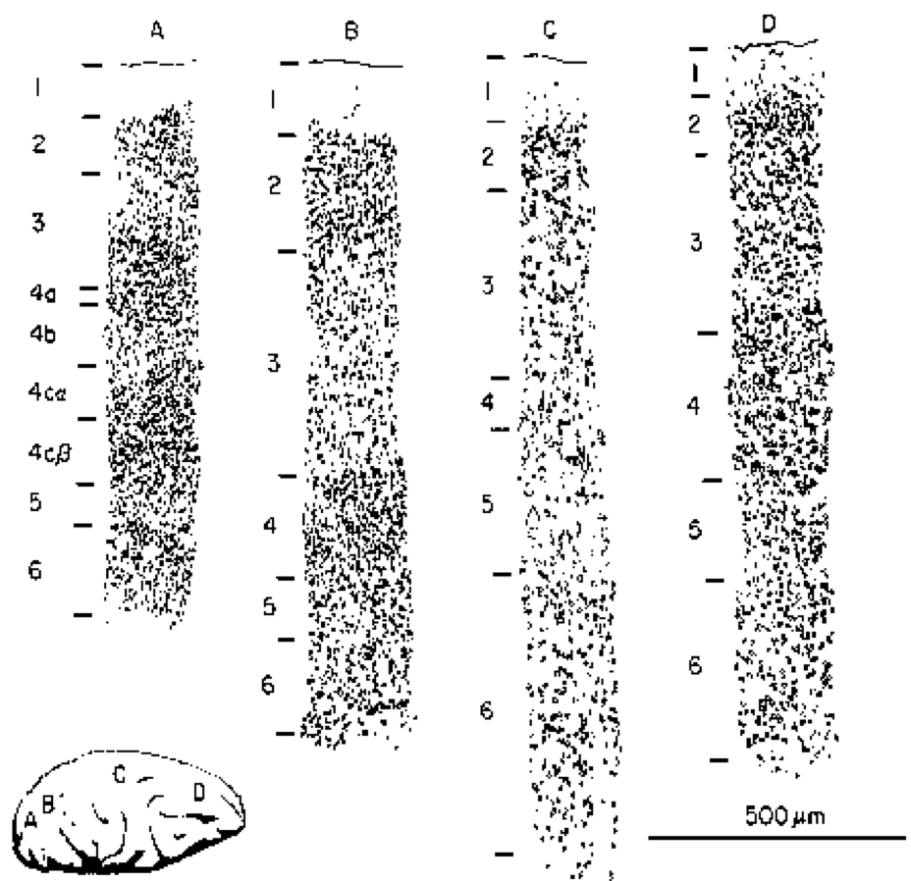
The 6 Layer Cake..

Slide 5
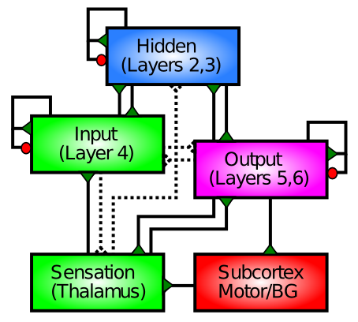
Is Actually Only 3..

Slide 6
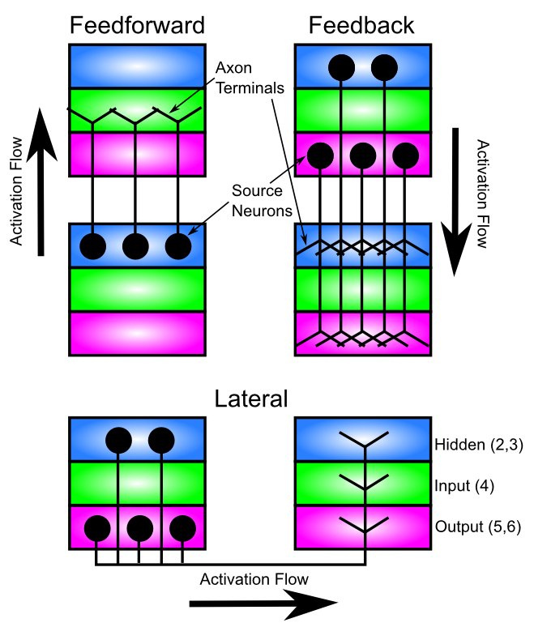
Patterns of Connectivity

Slide 7
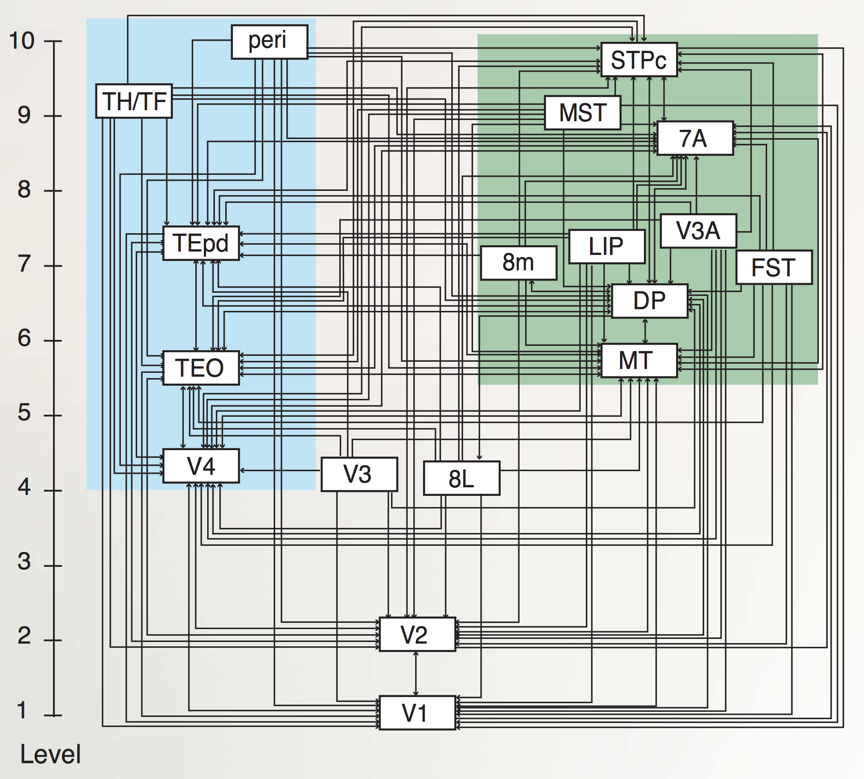
“Van Essen” Hierarchy
TE.. = Temporal
LIP, DP.. = Parietal
8L = Frontal Eye Field
To hippocampus:
TH/F = Parahippo
peri = Perirhinal
Markov et al., 2014

Slide 8
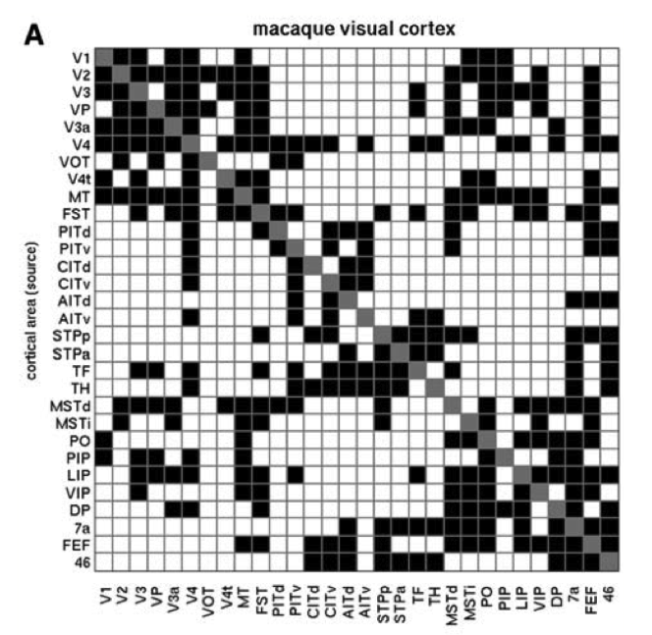
Bidirectional Symmetry

Slide 9
Biology => Function
Feedforward excitation => categorization
Feedback excitation => attractor dynamics
Lateral inhibition => competition, regulation

Slide 10
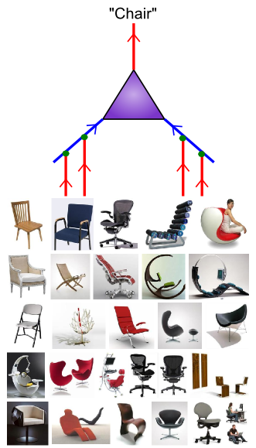
Detectors naturally perform categorization
Categorizing things properly is at least 80% of the solution to any problem:
Object recognition
Spoken word recognition
Idiom recognition
Relationship recognition
Person recognition
Action recognition
….

Slide 11
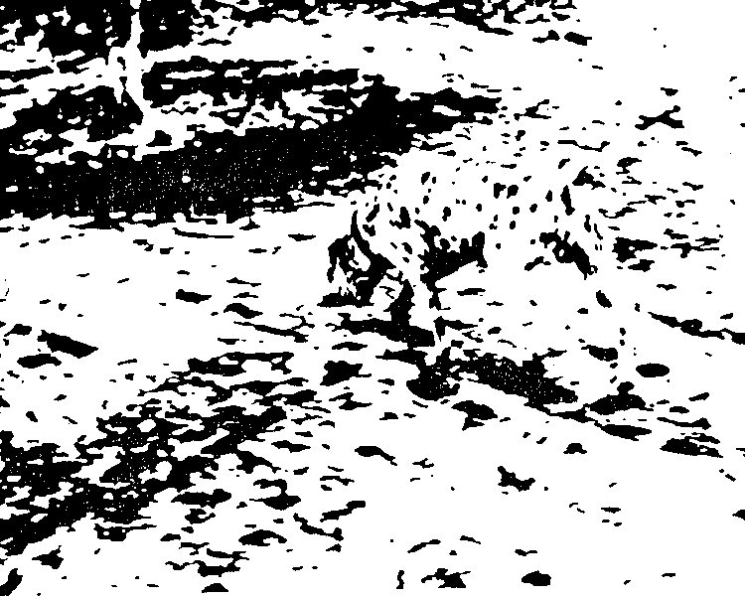
We Think in Categories
(much easier than disconnected pixels..)

Slide 12
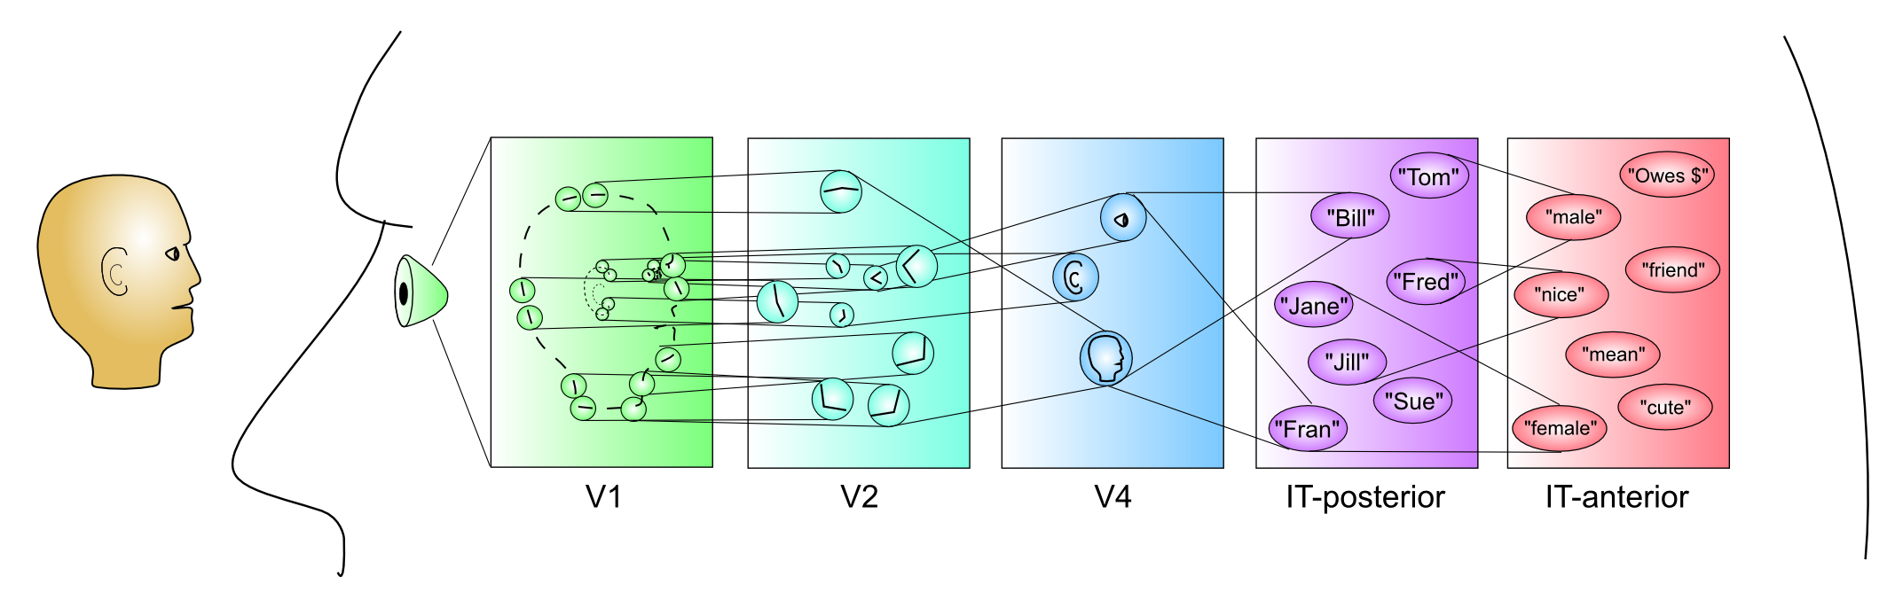
Hierarchy of Categories

Slide 13

The Chair Category

Slide 14
Getting the right ones is key..
Two men are dead in a cabin in the woods. What happened??

Slide 15
Categories are Interesting!
What makes a mental categorization accurate? Is there something “real” about a “chair?”
Stereotypes are mental categories..
Can you encode multiple categories at the same time??

Slide 16
Distributed Representations
Let a 1,000 categories bloom.. You’ve got the room in your head (billions of neurons)
Each neuron can respond to multiple things (graded similarity)
And each thing activates many neurons (who knows what is going to be relevant this time?)

Slide 17
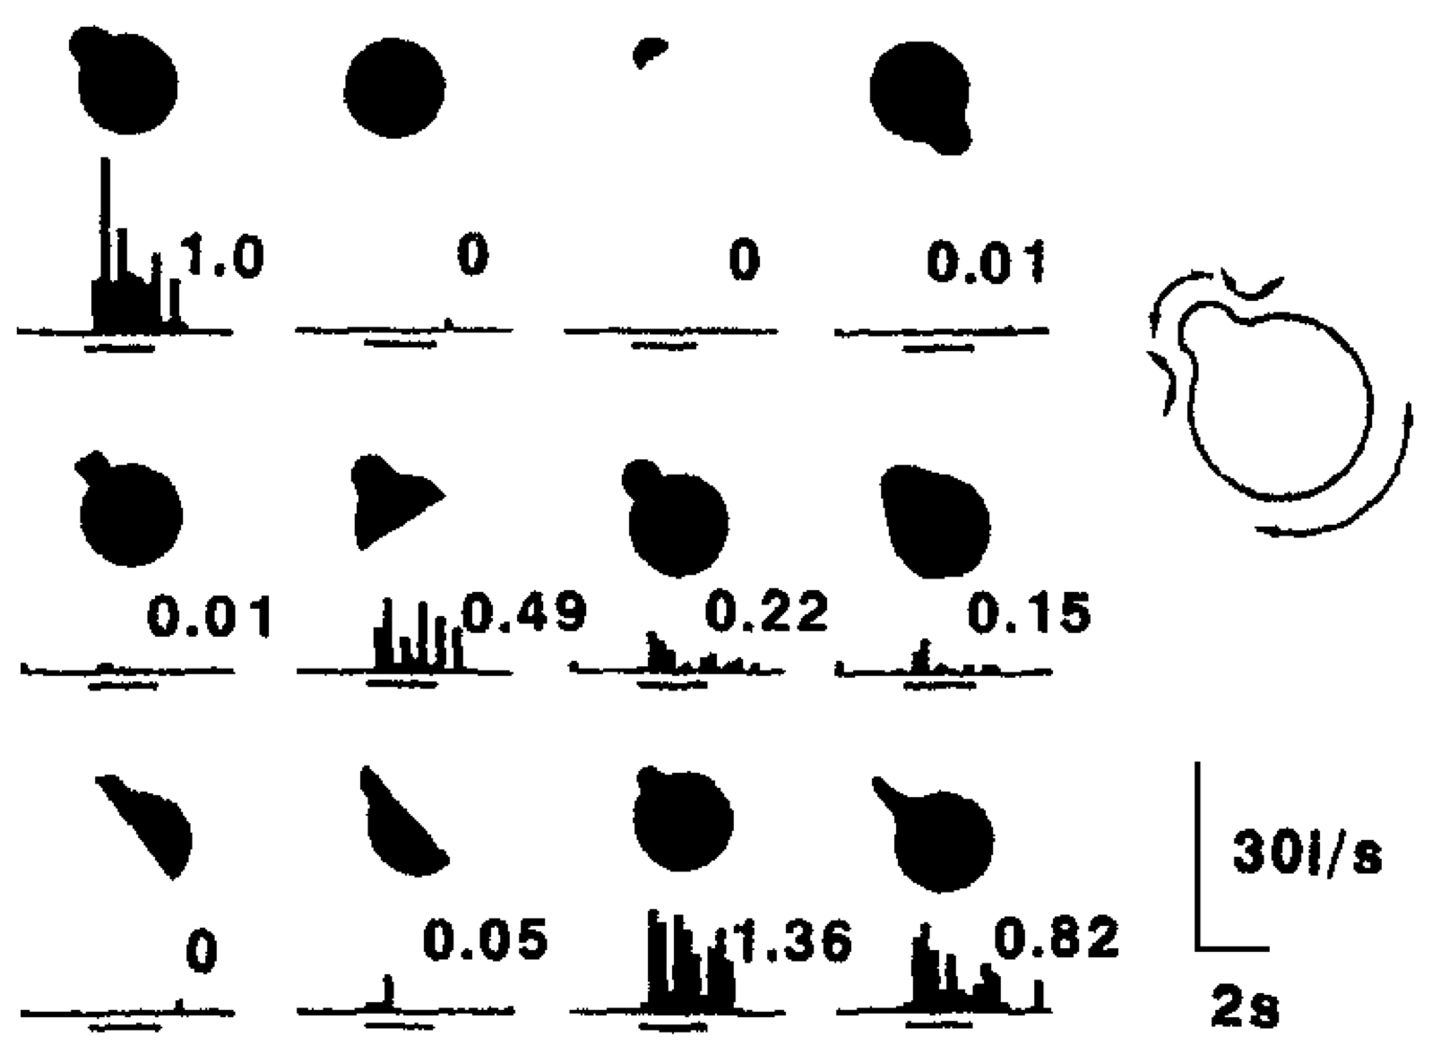
Graded Responses

Slide 18
Detection = Dimension
Detection = extracting relevant dimension from input: emotion detector, gender detector
face_categ example from Chapter 3

Slide 19
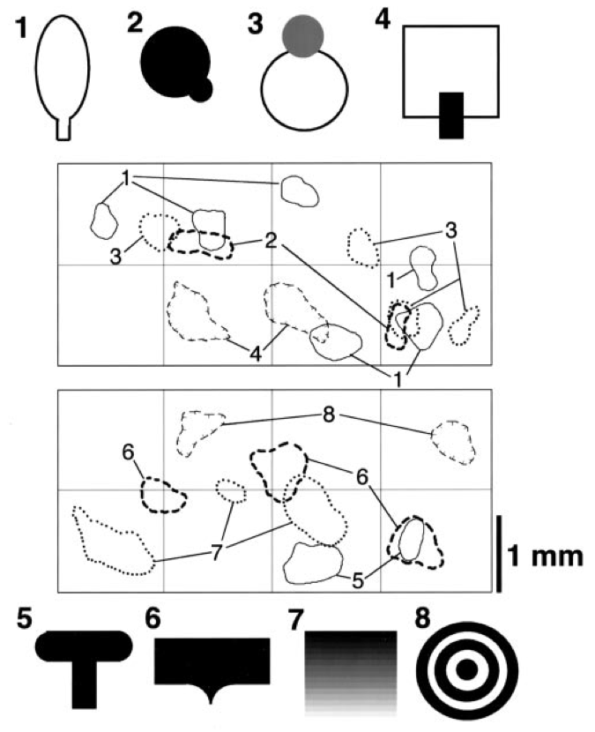
Distributed Patterns

Slide 20
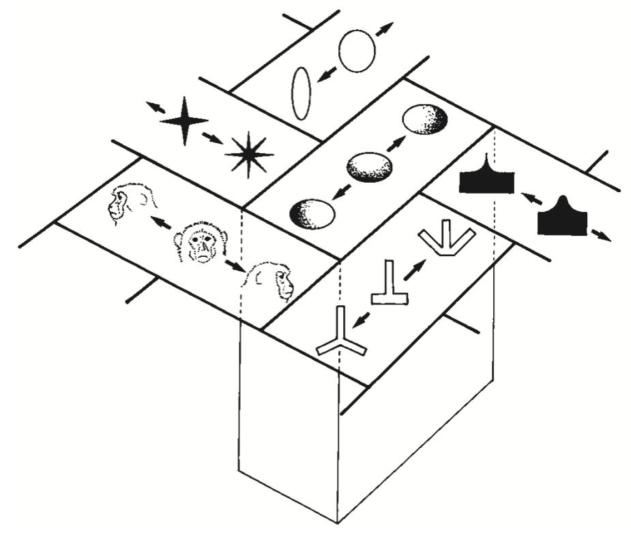
Topographic Organization

Slide 21
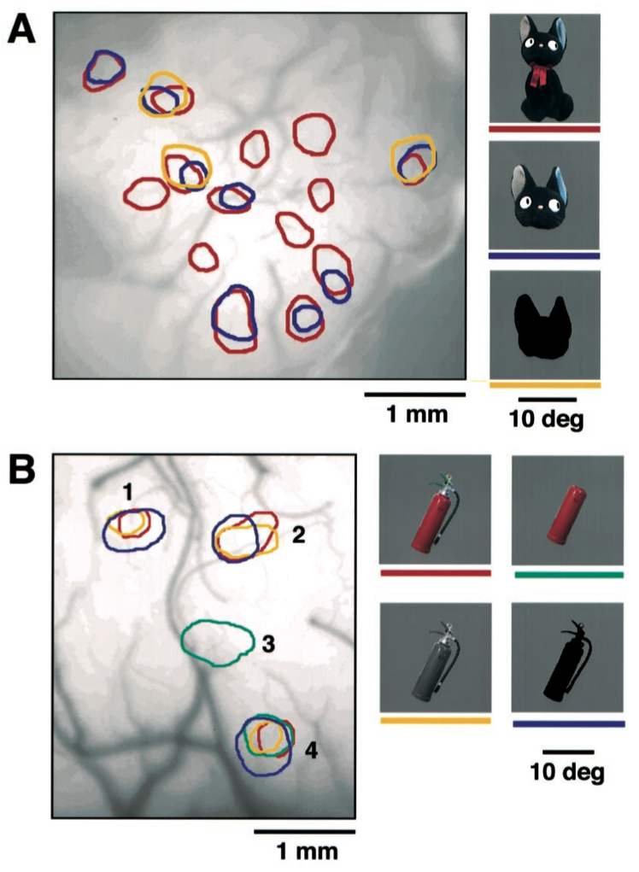
Distributed Parts

Slide 22
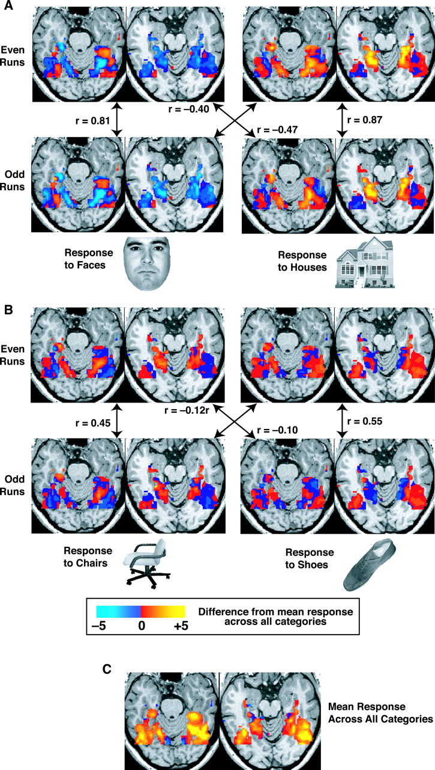
Not Just Monkeys

Slide 23
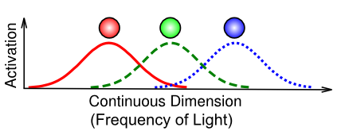
Coarse Coding Efficiency

Slide 24
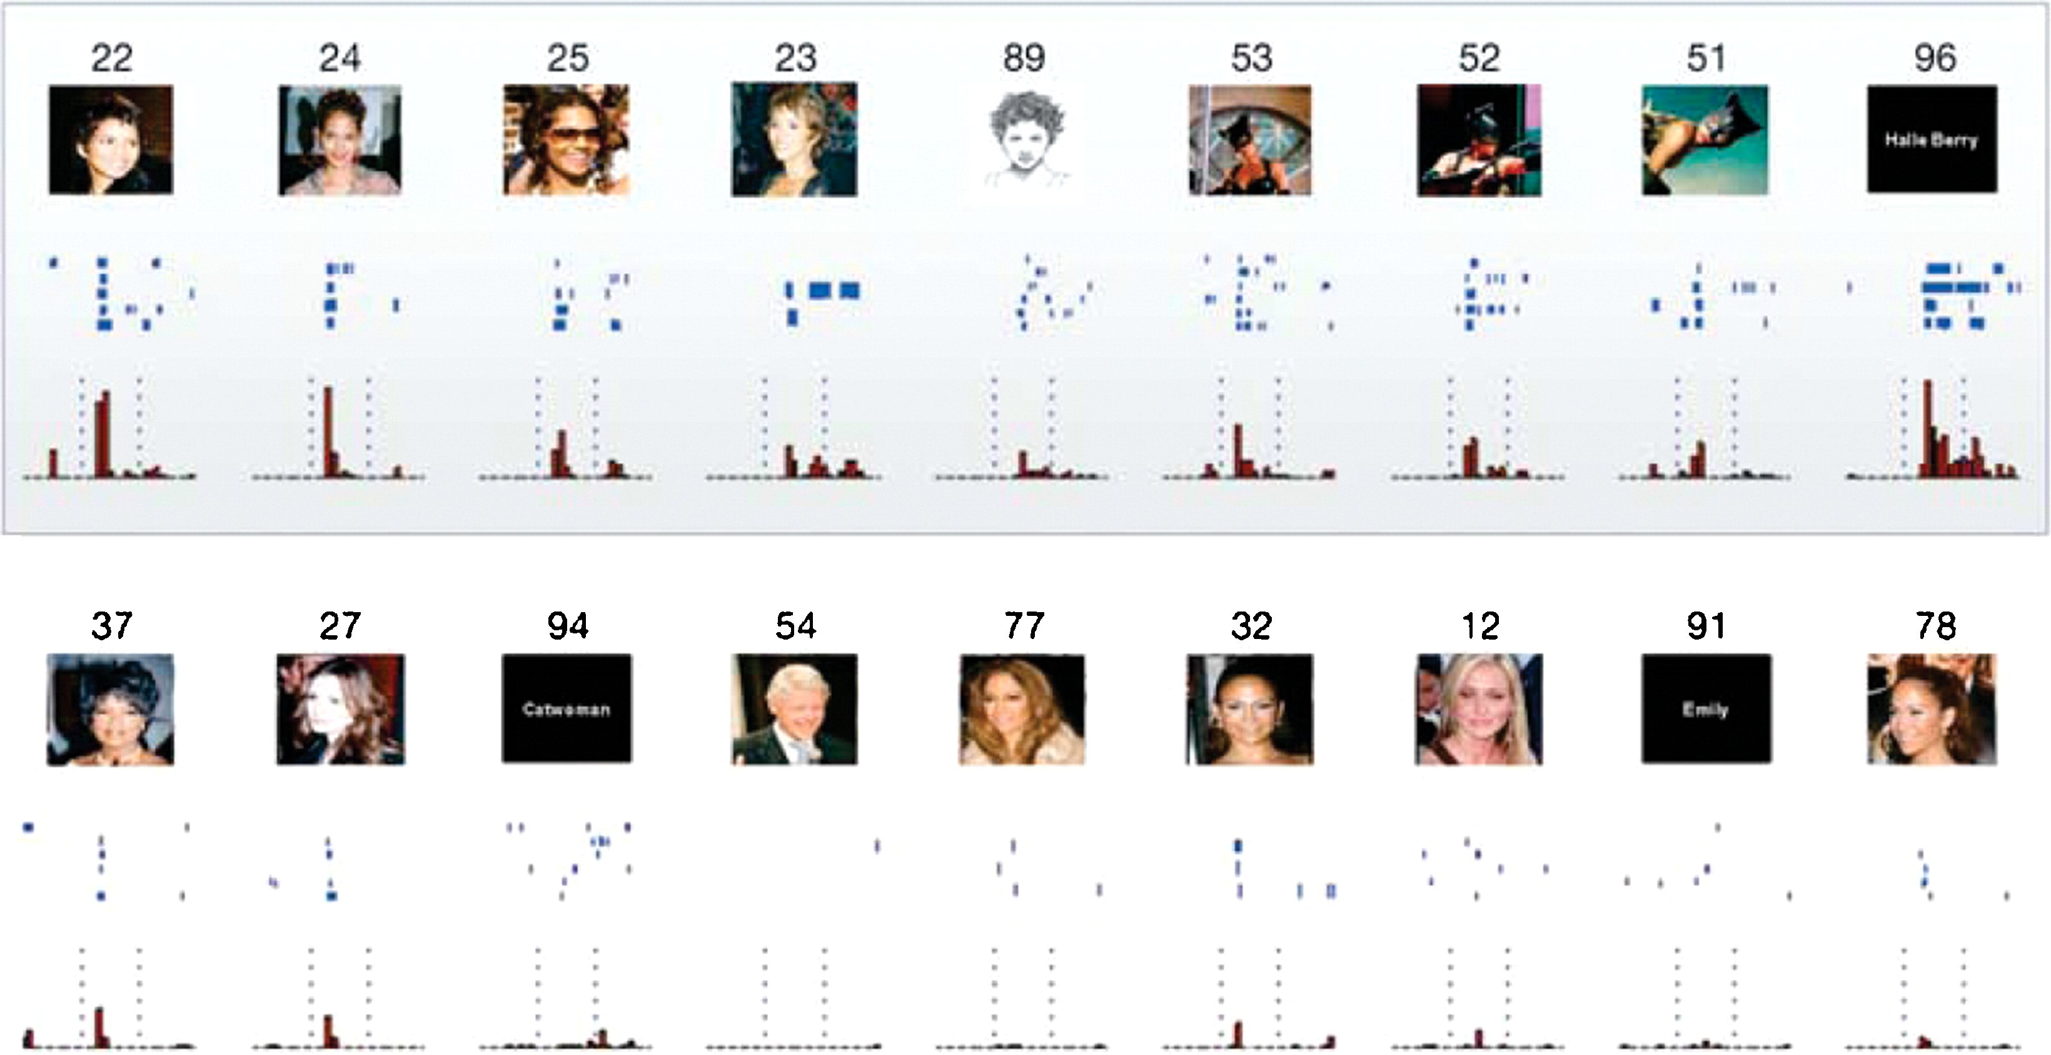
Localist Representations?

Slide 25
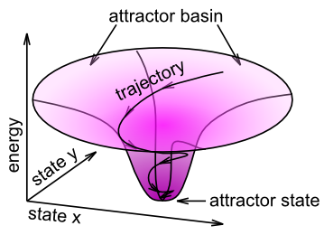
Bidirectional Excitatory Dynamics

Slide 26
Top-down Ambiguity Resolution

Slide 27
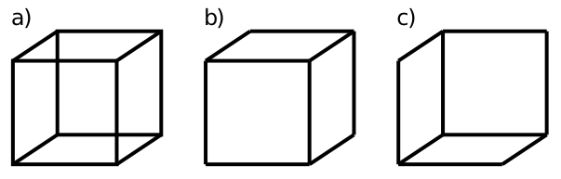
Behold, the cube!

Slide 28

What Are These?

Slide 29
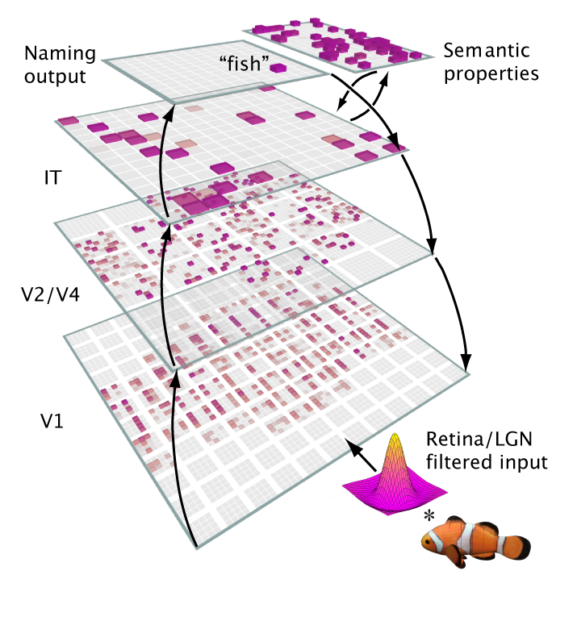
A Big Network Model..

Slide 30

Bidirectional Dynamics

Slide 31
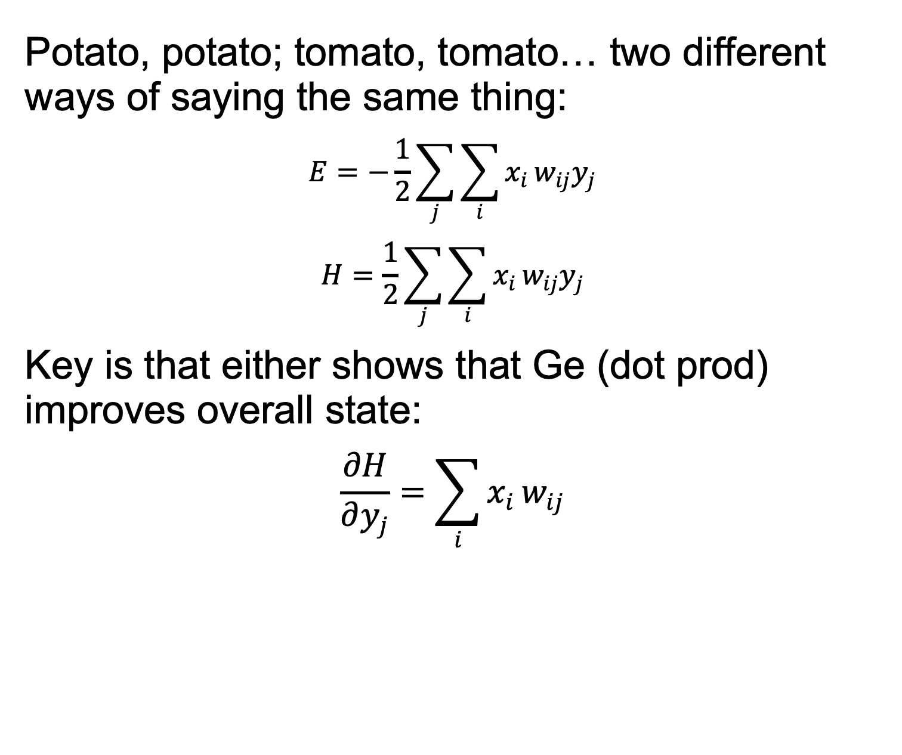
You say Energy, I say Harmony!
Potato, potato; tomato, tomato… two different ways of saying the same thing:
$$E=−\frac{1}{2}\sum_{j}^{​}{\sum_{i}^{​}{x_{i}}}w_{ij}y_{j}$$
$$H=\frac{1}{2}\sum_{j}^{​}{\sum_{i}^{​}{x_{i}}}w_{ij}y_{j}$$
Key is that either shows that Ge (dot prod) improves overall state:
$$\frac{∂H}{∂y_{j}}=\sum_{i}^{​}{x_{i}}w_{ij}$$

Slide 32
Inhibition
Competition: selection pressure, survival of the “fittest”, picking the best detector for the job..
Interacts with learning: “rich get richer” (but also narrower – no hogging the inputs please!)
“Sparse distributed representations”
(and also essential for controlling activity, like an air conditioner)

Slide 33
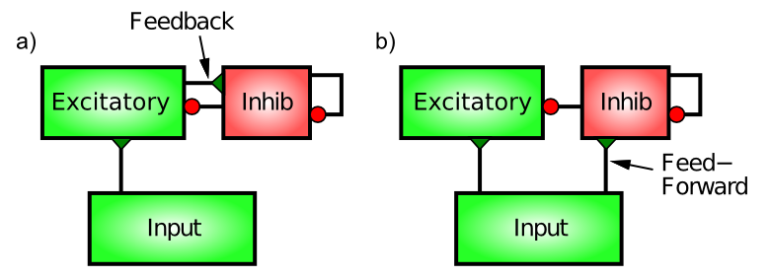
Feedforward and Feedback Inhib
Feedback “reacts” (AC comes on after it gets hot enough)
Feedforward “anticipates” (e.g., if AC measured outdoor temp, or weather forecast)

Slide 34
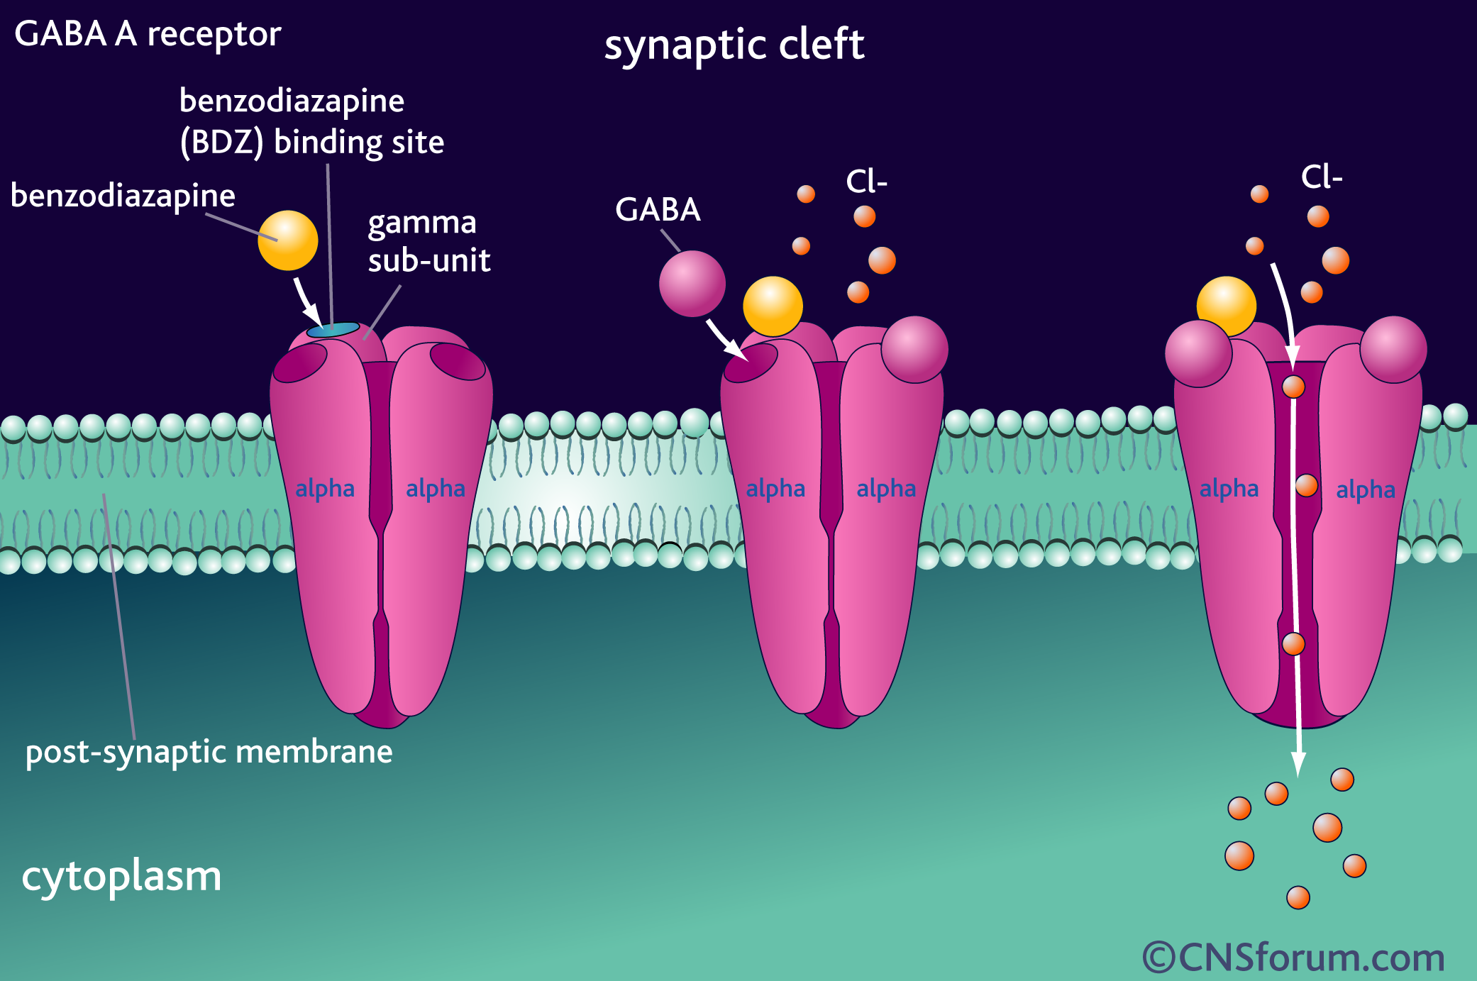
Benzo, Valium, Xanax, etc
Agonists for GABA inhibitory channels
Muscimol widely used in neuro studies to turn off brain areas
Midazolam used in anesthesia
Bicuculline = GABA antagonist removes inhibition (not safe in whole brains!)

Slide 35
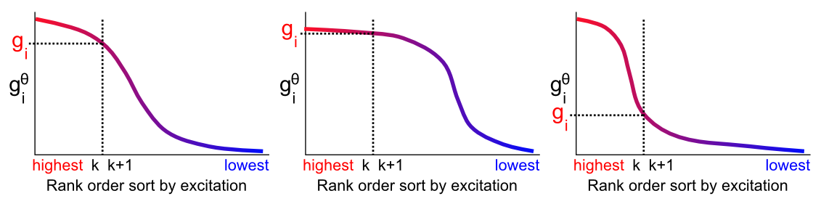
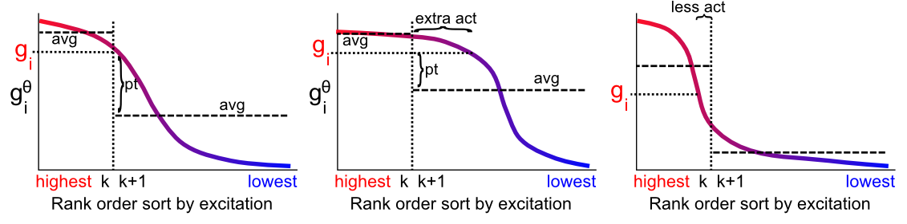
kWTA Approximation

